Slide 1

Independent study: Image and Audio Generation and Editing using Python
Phileas Dazeley Gaist, College of the Atlantic, Fall term 2021

Slide 2
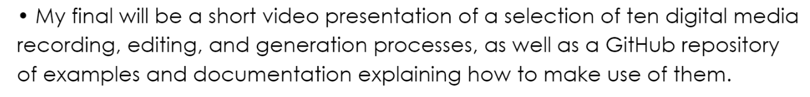

Slide 3
Media files == arrays of data
Image files = 2d or 2d arrays of shape (height, width, channels)
Audio files = n-dimensional arrays of shape of shape (channel1, channel2…) + a sample rate
Video files ≈ a list of arrays of images + an audio array

Slide 4
N-dimensional arrays = n-dimensional arrays subdivided N-n times
Where N represents a number of dimensions superior to n.
A 1d array can be turned into a 2d array by splitting the dimension of the array into a number of smaller arrays (one division).
A 2d array can be turned into a 3d array by dividing the “deepest” axis of the array into a number of smaller arrays (one division)
To go from a 1d array to a 3d array requires a 2 division of the axis of the 1d array. This principle is generalisable to any number of dimensions.

Slide 5
What this means: the number of dimensions doesn’t really matter
For our purposes, we can edit audio or image arrays using the same tools.
*This does not extent to video because videos are more analogous to lists: they contain arrays of different types and different sizes, which contrary to variances in the number of dimensions, makes our life a little harder.

Slide 6
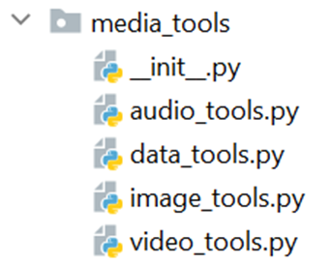
The `media_tools` package
Data can be
Mapped
Transformed
Generated
Messed with (transformations, but wacky)
Notes:
To facilitate the task of working with image, audio, and video data in python, I have compiled a list of convenience functions into a package called `media_tools`, which allows for a number of media manipulation and generation approaches.

Slide 7
Examples:
Mapping, Transforming, and Generating data to be saved as different media types.

Slide 8
Mapping

Slide 9
Transformations

Slide 10
Generation

Slide 11
How to use this project yourself
Download Python
Head to https://github.com/phileasdg/Image_and_Audio_Generation_and_Editing_using_Python and download my code
Install the dependencies using the command: pip install -r requirements.txt
Mess around and have fun!

Slide 12
Bibliography

